Slide 1
Probability Theorem
Image Informatics Lab.

Slide 2
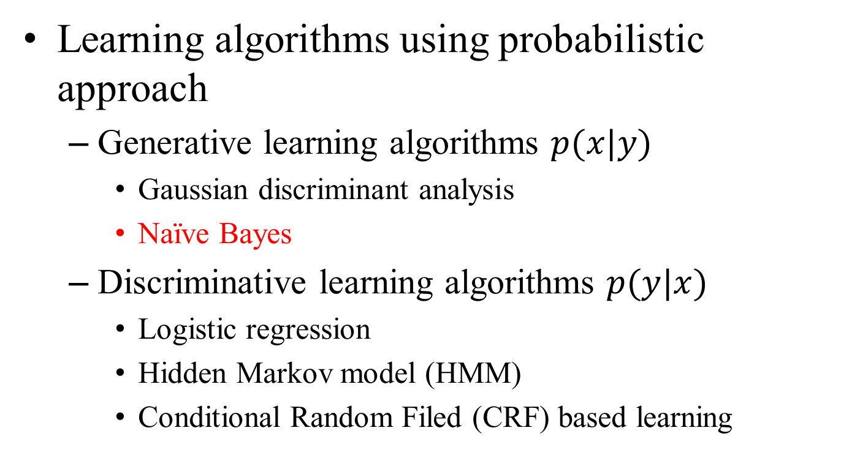
A glance of learning algorithm
Learning algorithms using probabilistic approach
Generative learning algorithms $p(x|y)$
Gaussian discriminant analysis
Naïve Bayes
Discriminative learning algorithms $p(y|x)$
Logistic regression
Hidden Markov model (HMM)
Conditional Random Filed (CRF) based learning

Slide 3
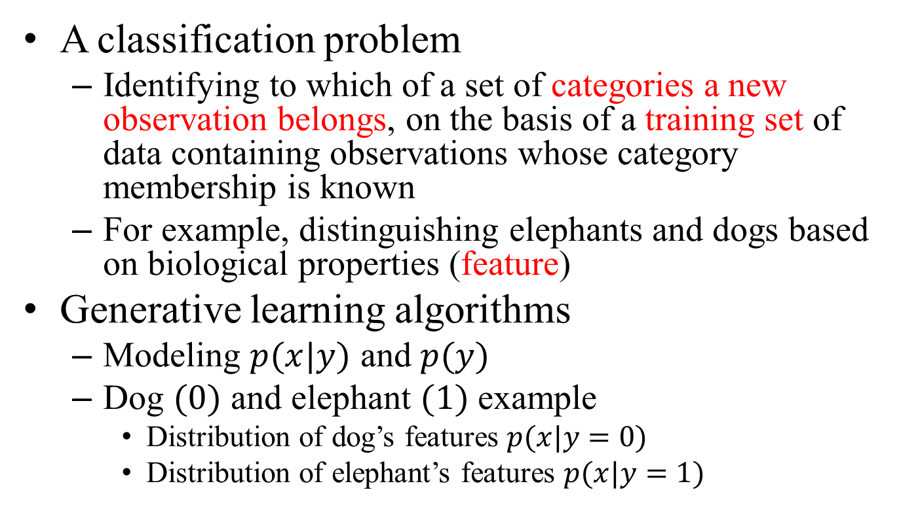
Underlying concepts to understand the naïve Bayes classifier
A classification problem
Identifying to which of a set of categories a new observation belongs, on the basis of a training set of data containing observations whose category membership is known
For example, distinguishing elephants and dogs based on biological properties (feature)
Generative learning algorithms
Modeling $p(x|y)$ and $p(y)$
Dog $(0)$ and elephant $(1)$ example
Distribution of dog’s features $p(x|y=0)$
Distribution of elephant’s features $p(x|y=1)$

Slide 4
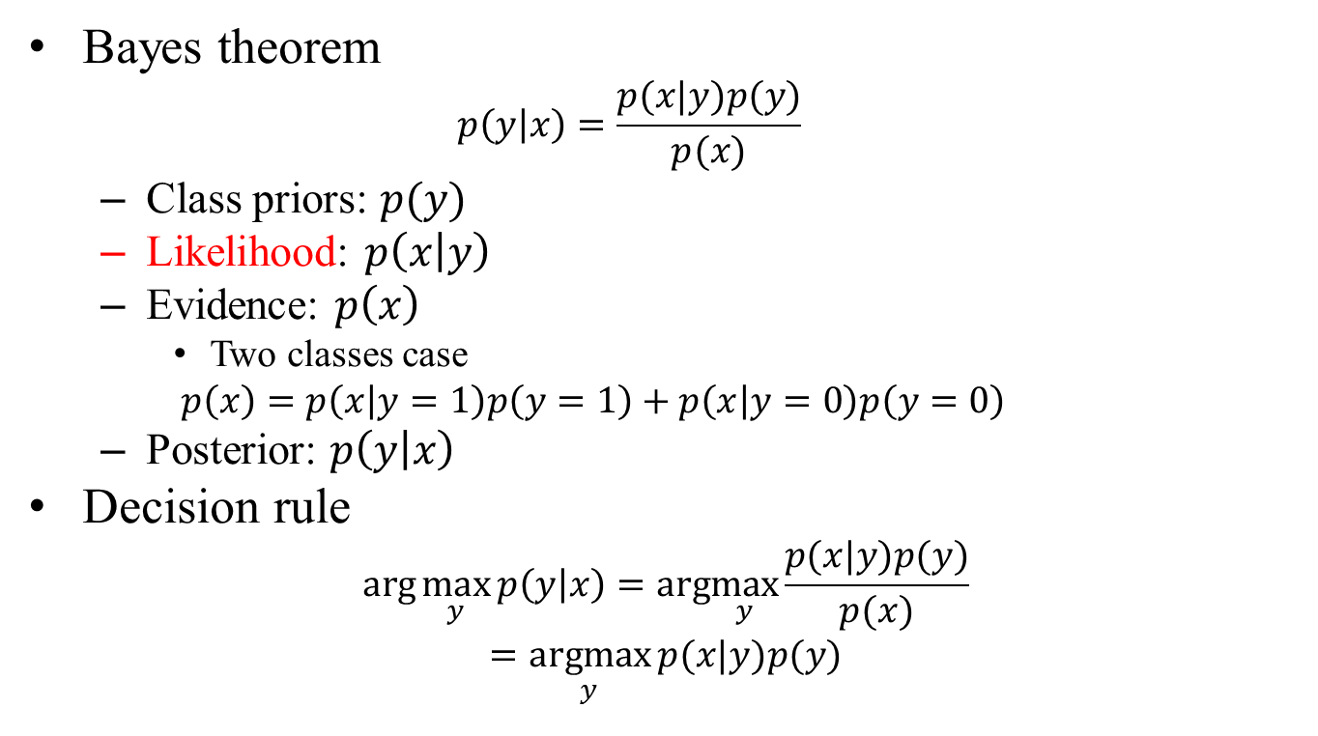
Generative learning algorithm
Bayes theorem
$$p\left(y | x\right)=\frac{p(x|y)p(y)}{p(x)}$$
Class priors: $p(y)$
Likelihood: $p\left(x | y\right)$
Evidence: $p\left(x\right)$
Two classes case
$$p\left(x\right)=p\left(x | y=1\right)p\left(y=1\right)+p\left(x | y=0\right)p\left(y=0\right)$$
Posterior: $p\left(y | x\right)$
Decision rule
$$arg\max_{y}{p\left(y | x\right)}=arg\max_{y}{\frac{p(x|y)p(y)}{p(x)}}$$
$$=\underset{y}{argmax}{p(x|y)p(y)}$$

Slide 5
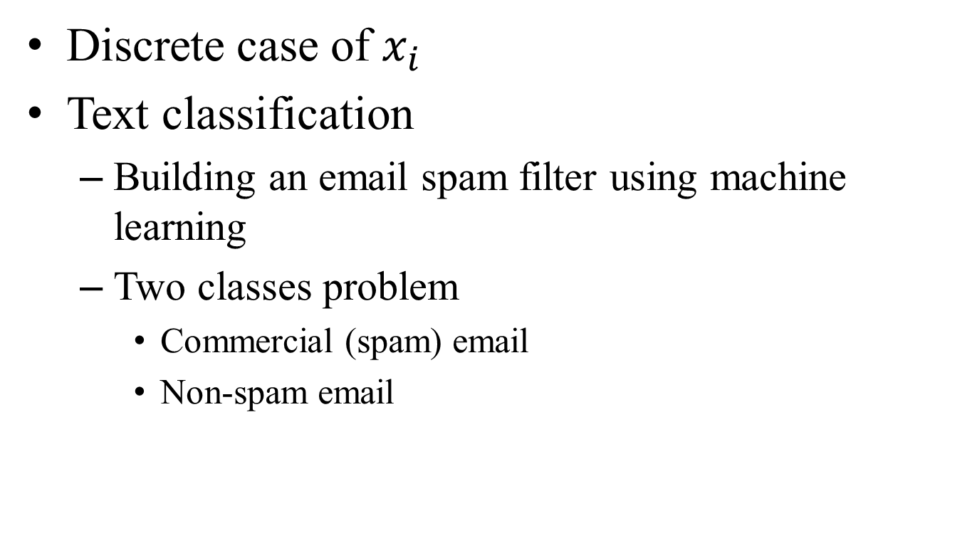
Naïve Bayes classifier for text classification
Discrete case of $x_{i}$
Text classification
Building an email spam filter using machine learning
Two classes problem
Commercial (spam) email
Non-spam email

Slide 6

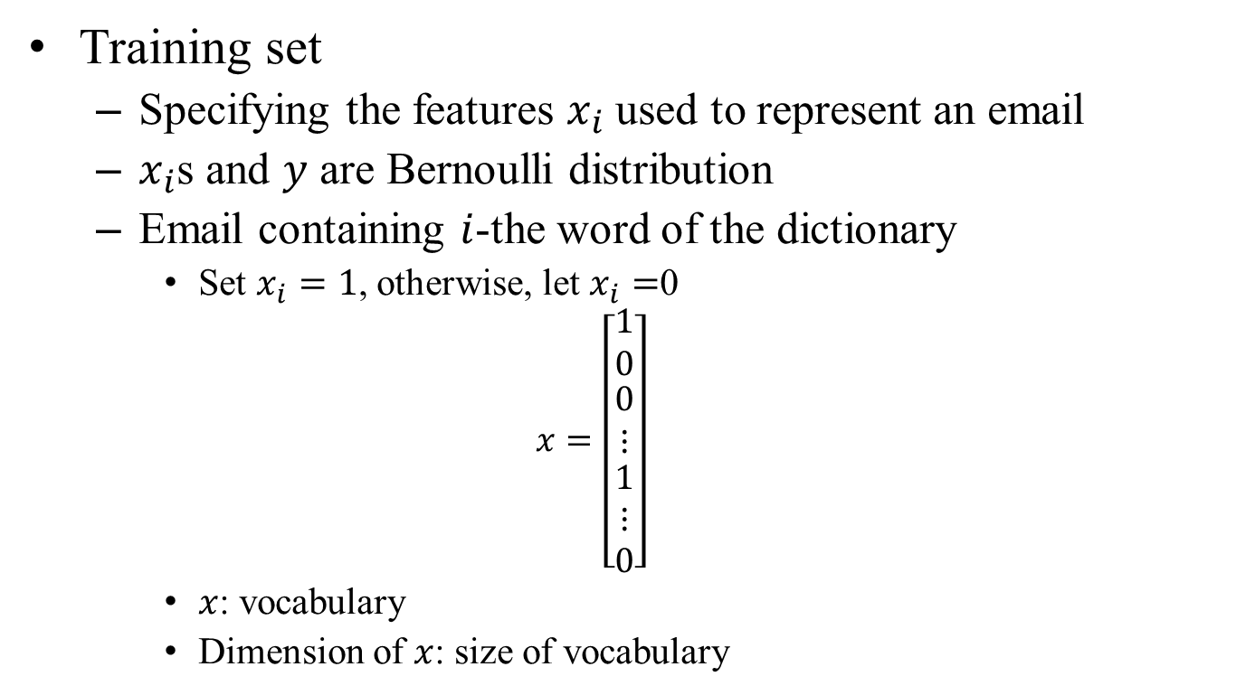
Naïve Bayes classifier for text classification (count.)
Training set
Specifying the features $x_{i}$ used to represent an email
$x_{i}$s and $y$ are Bernoulli distribution
Email containing $i$-the word of the dictionary
Set $x_{i}=1$, otherwise, let $x_{i}=$0
$$x=\left[\begin{matrix}1 \\ 0 \\ \begin{matrix}0 \\ ⋮ \\ \begin{matrix}1 \\ ⋮ \\ 0\end{matrix}\end{matrix}\end{matrix}\right]$$
$x$: vocabulary
Dimension of $x$: size of vocabulary
a
art
algorithm
$⋮$
buy
$⋮$
zealot

Slide 7
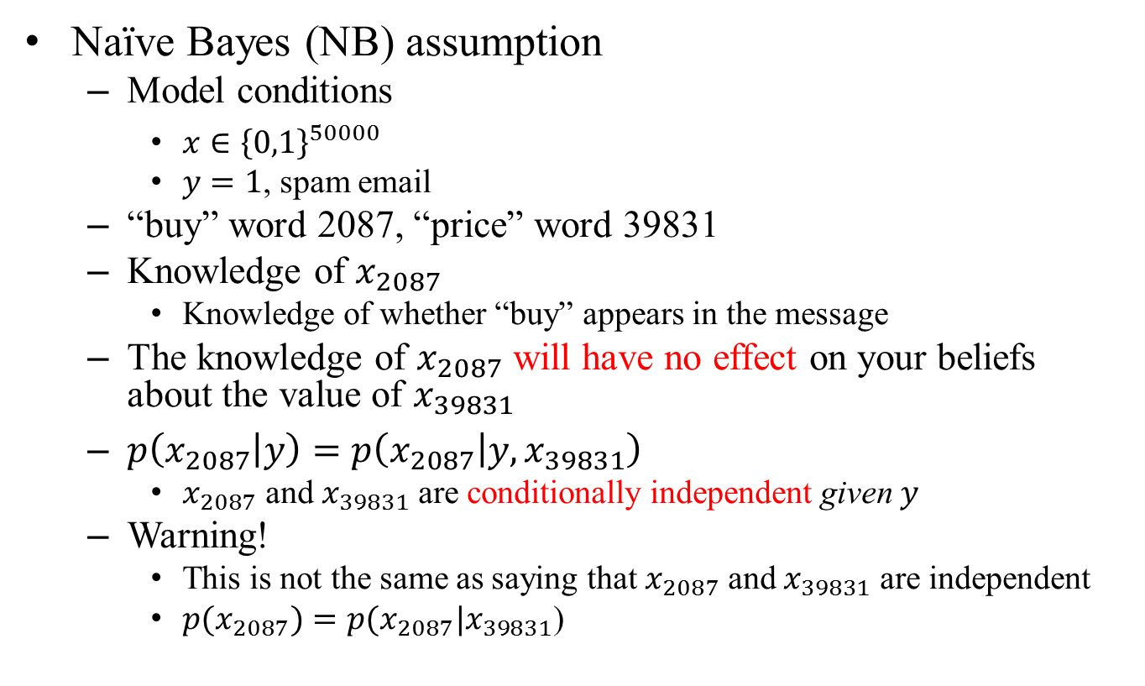

Modeling $p(x|y)$
Naïve Bayes (NB) assumption
Model conditions
$x∈{\left\{0,1\right\}}^{50000}$
$y=1$, spam email
“buy” word 2087, “price” word 39831
Knowledge of $x_{2087}$
Knowledge of whether “buy” appears in the message
The knowledge of $x_{2087}$ will have no effect on your beliefs about the value of $x_{39831}$
$p\left(x_{2087} | y\right)=p\left(x_{2087} | y,x_{39831}\right)$
$x_{2087}$ and $x_{39831}$ are conditionally independent given $y$
Warning!
This is not the same as saying that $x_{2087}$ and $x_{39831}$ are independent
$p(x_{2087})=p(x_{2087}|x_{39831}$)

Slide 8
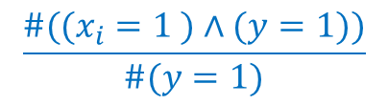
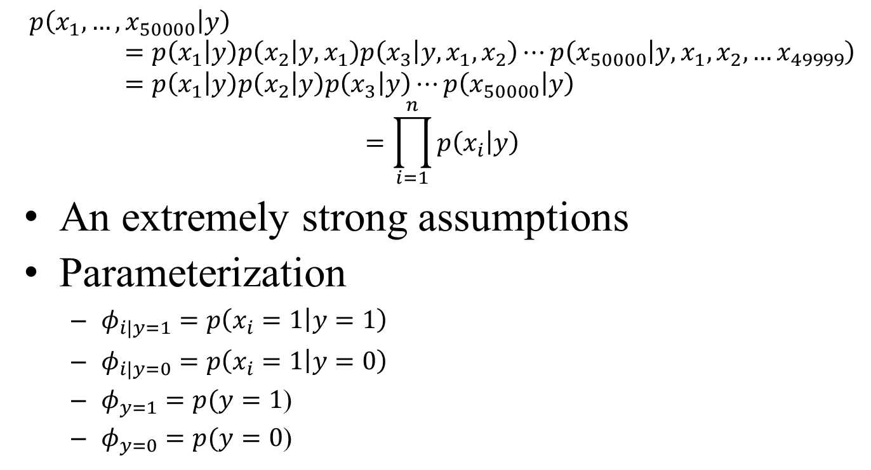
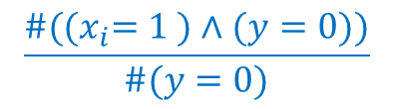
NB assumption
$$p\left(x_{1},…,x_{50000} | y\right)=p\left(x_{1} | y\right)p\left(x_{2} | y,x_{1}\right)p\left(x_{3} | y,x_{1},x_{2}\right)⋯p\left(x_{50000} | y,x_{1},x_{2},…x_{49999}\right)=p\left(x_{1} | y\right)p\left(x_{2} | y\right)p\left(x_{3} | y\right)⋯p\left(x_{50000} | y\right)$$
$$=\prod_{i=1}^{n}{p\left(x_{i} | y\right)}$$
An extremely strong assumptions
Parameterization
$φ_{i|y=1}=p\left(x_{i}=1 | y=1\right)$
$φ_{i|y=0}=p\left(x_{i}=1 | y=0\right)$
$φ_{y=1}=p(y=1$)
$φ_{y=0}=p(y=0$)
$$\frac{\#((x_{i}=1 )∧(y=1))}{\#(y=1)}$$
P(“i-th word appears when spam”)
$$\frac{\#({(x}_{i}=1 )∧(y=0))}{\#(y=0)}$$
P(“i-th word appears when NON-spam”)
p(“spam”)
p(“NON-spam”)

Slide 9
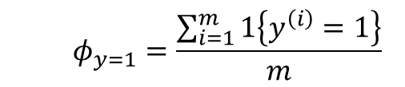
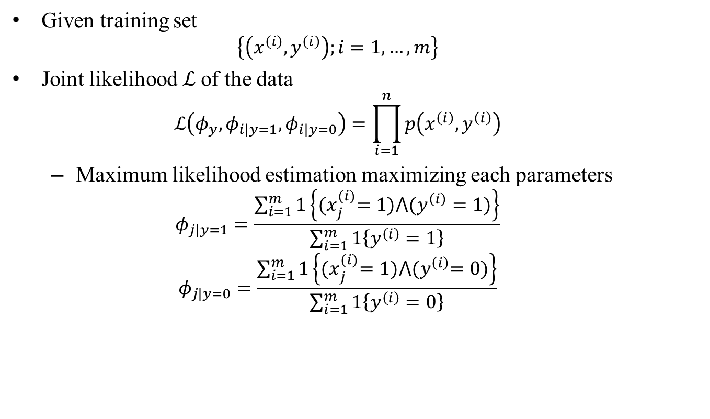
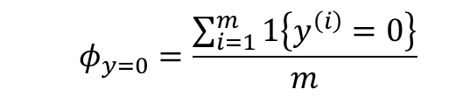
Model conditions
Given training set
$$\left\{\left(x^{\left(i\right)},y^{\left(i\right)}\right);i=1,…,m\right\}$$
Joint likelihood $ℒ$of the data
$$ℒ\left(φ_{y},φ_{i|y=1},φ_{i|y=0}\right)=\prod_{i=1}^{n}{p\left(x^{\left(i\right)},y^{\left(i\right)}\right)}$$
Maximum likelihood estimation maximizing each parameters
$$φ_{j|y=1}=\frac{\sum_{i=1}^{m}{1\left\{{(x}_{j}^{(i)}=1)⋀(y^{\left(i\right)}=1)\right\}}}{\sum_{i=1}^{m}{1\left\{y^{\left(i\right)}=1\right\}}}$$
$$φ_{j|y=0}=\frac{\sum_{i=1}^{m}{1\left\{{(x}_{j}^{(i)}=1)⋀{(y}^{\left(i\right)}=0)\right\}}}{\sum_{i=1}^{m}{1\left\{y^{\left(i\right)}=0\right\}}}$$
In i-th training data, j-th word appears and the training data is a spam
The total number of spams
Indicator function
(1 if true, 0 if false)
In i-th training data, j-th word appears and the training data is NOT a spam
The total number of NON-spams
$$φ_{y=1}=\frac{\sum_{i=1}^{m}{1\left\{y^{\left(i\right)}=1\right\}}}{m}$$
$$φ_{y=0}=\frac{\sum_{i=1}^{m}{1\left\{y^{\left(i\right)}=0\right\}}}{m}$$
Prior: p(“spam”)
Prior: p(“NON-spam”)

Slide 10
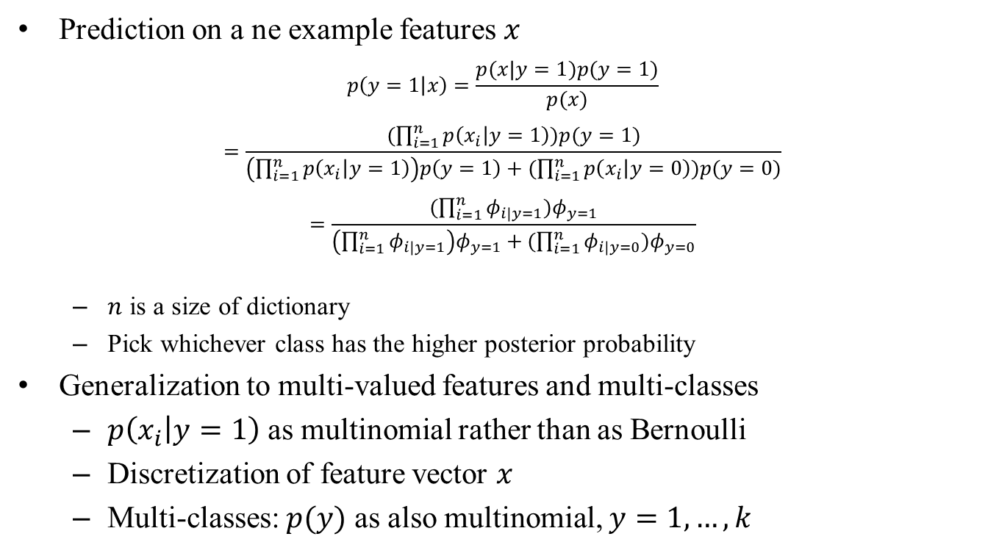
Naïve Bayes classifier for text classification based on NB assumption
Prediction on a ne example features $x$
$$p\left(y=1 | x\right)=\frac{p(x|y=1)p(y=1)}{p(x)}$$
$$=\frac{(\prod_{i=1}^{n}{p\left(x_{i} | y=1\right)})p(y=1)}{\left(\prod_{i=1}^{n}{p\left(x_{i} | y=1\right)}\right)p\left(y=1\right)+(\prod_{i=1}^{n}{p\left(x_{i} | y=0\right)})p(y=0)}$$
$$=\frac{(\prod_{i=1}^{n}{φ_{i|y=1}})φ_{y=1}}{\left(\prod_{i=1}^{n}{φ_{i|y=1}}\right)φ_{y=1}+(\prod_{i=1}^{n}{φ_{i|y=0}})φ_{y=0}}$$
$n$ is a size of dictionary
Pick whichever class has the higher posterior probability
Generalization to multi-valued features and multi-classes
$p\left(x_{i} | y=1\right)$ as multinomial rather than as Bernoulli
Discretization of feature vector $x$
Multi-classes: $p(y)$ as also multinomial, $y=1,…,k$
Normalization term

Slide 11
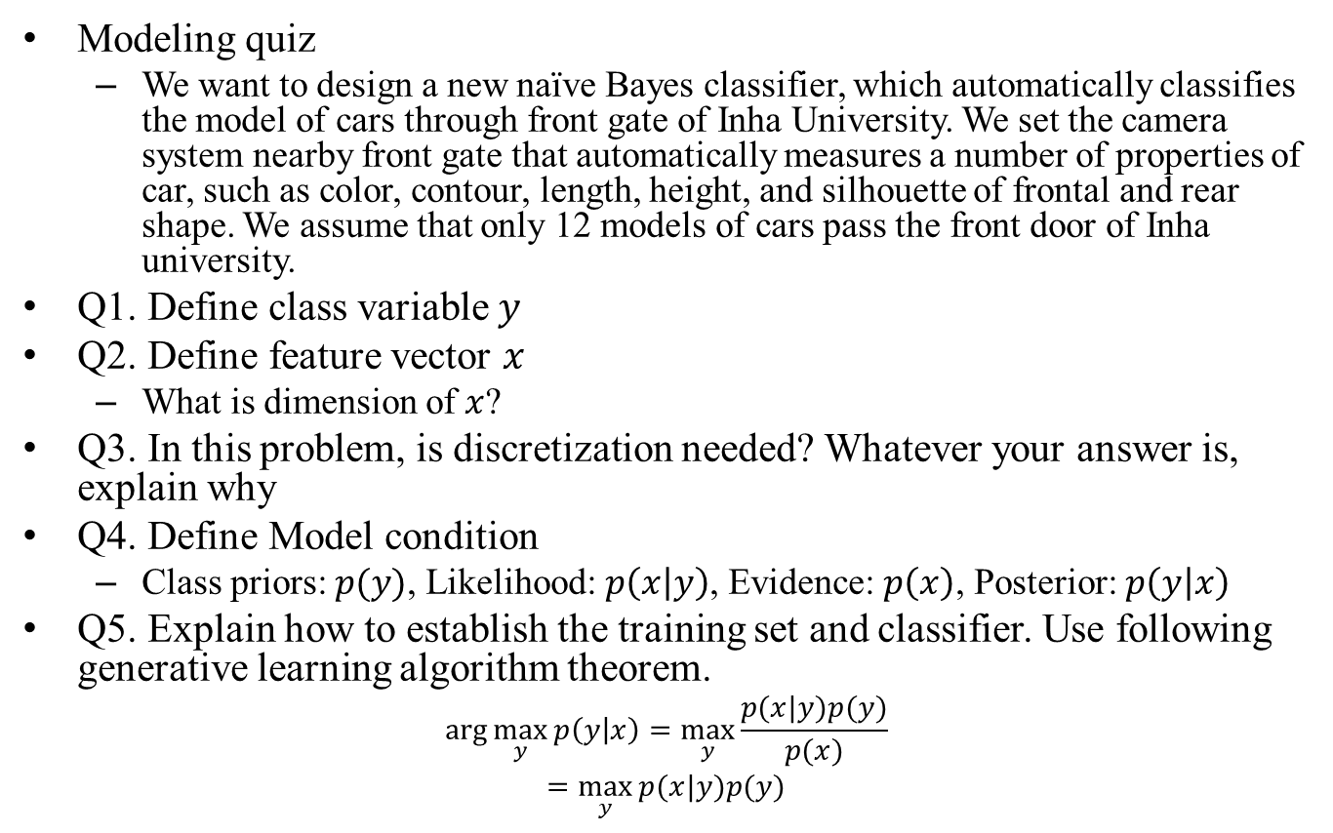
Pop quiz
Modeling quiz
We want to design a new naïve Bayes classifier, which automatically classifies the model of cars through front gate of Inha University. We set the camera system nearby front gate that automatically measures a number of properties of car, such as color, contour, length, height, and silhouette of frontal and rear shape. We assume that only 12 models of cars pass the front door of Inha university.
Q1. Define class variable $y$
Q2. Define feature vector $x$
What is dimension of $x$?
Q3. In this problem, is discretization needed? Whatever your answer is, explain why
Q4. Define Model condition
Class priors: $p(y)$, Likelihood: $p\left(x | y\right)$, Evidence: $p\left(x\right)$, Posterior: $p\left(y | x\right)$
Q5. Explain how to establish the training set and classifier. Use following generative learning algorithm theorem.
$$arg\max_{y}{p\left(y | x\right)}=\max_{y}{\frac{p(x|y)p(y)}{p(x)}}$$
$$=\max_{y}{p(x|y)p(y)}$$

Slide 12
Summary
Why learn the probability theorem?
Deterministic and stochastic system
Machine learning
Best examples using probability theorem
Algorithms
Applications
Generative learning algorithm
Naïve Bayes classifier
Text classification
Laplace smoothing

Slide 13

Implementation Issues on Text Classification
Database example
Total 7 e-mails: 6 training and 1 test
$$x=\left[\begin{matrix}cs \\ image \\ probability\end{matrix}\right]$$
Spam
 | 1 | 2 | 3
cs | 1 | 0 | 0
image | 0 | 1 | 1
probability | 1 | 1 | 1
Non-spam
 | 1 | 2 | 3
cs | 1 | 0 | 1
image | 1 | 0 | 1
probability | 0 | 0 | 1 (0)

Slide 14
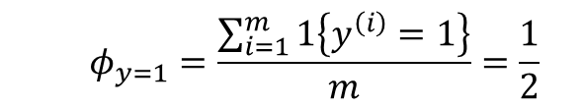

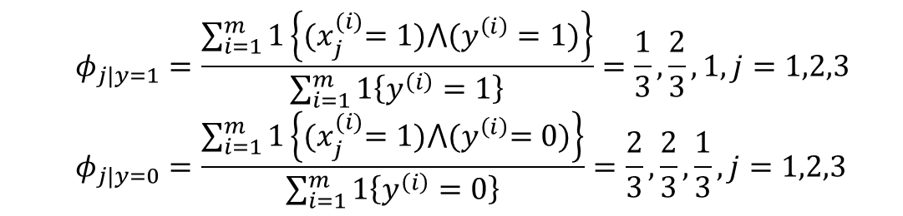
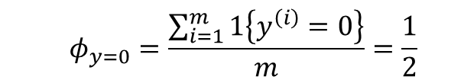
Implementation Issues on Text Classification
Parameterization
Total number of training e-mail $m=6$
Total number of words (size of vocabulary) $n=3$
$$φ_{j|y=1}=\frac{\sum_{i=1}^{m}{1\left\{{(x}_{j}^{(i)}=1)⋀(y^{\left(i\right)}=1)\right\}}}{\sum_{i=1}^{m}{1\left\{y^{\left(i\right)}=1\right\}}}=\frac{1}{3},\frac{2}{3},1, j=1,2,3$$
$$φ_{j|y=0}=\frac{\sum_{i=1}^{m}{1\left\{{(x}_{j}^{(i)}=1)⋀{(y}^{\left(i\right)}=0)\right\}}}{\sum_{i=1}^{m}{1\left\{y^{\left(i\right)}=0\right\}}}=\frac{2}{3},\frac{2}{3},\frac{1}{3}, j=1,2,3$$
$$φ_{y=1}=\frac{\sum_{i=1}^{m}{1\left\{y^{\left(i\right)}=1\right\}}}{m}=\frac{1}{2}$$
$$φ_{y=0}=\frac{\sum_{i=1}^{m}{1\left\{y^{\left(i\right)}=0\right\}}}{m}=\frac{1}{2}$$

Slide 15

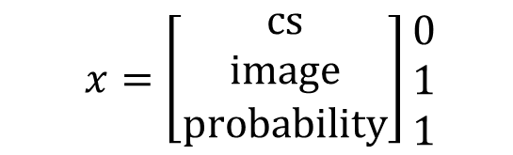

Implementation Issues on Text Classification
Classification
$$x=\left[\begin{matrix}cs \\ image \\ probability\end{matrix}\right]\begin{matrix}0 \\ 1 \\ 1\end{matrix}$$
$$p\left(y=1 | x\right)=\frac{p(x|y=1)p(y=1)}{p(x)}$$
$$=\frac{(\prod_{i=1}^{n}{p\left(x_{i} | y=1\right)})p(y=1)}{\left(\prod_{i=1}^{n}{p\left(x_{i} | y=1\right)}\right)p\left(y=1\right)+(\prod_{i=1}^{n}{p\left(x_{i} | y=0\right)})p(y=0)}$$
$$=\frac{(\prod_{i=1}^{n}{φ_{i|y=1}})φ_{y=1}}{\left(\prod_{i=1}^{n}{φ_{i|y=1}}\right)φ_{y=1}+(\prod_{i=1}^{n}{φ_{i|y=0}})φ_{y=0}}≈\left(\prod_{i=1}^{n}{φ_{i|y=1}}\right)φ_{y=1}$$
$$=\frac{2}{3}∙1∙\frac{1}{2}=\frac{1}{3}$$
$$p\left(y=1 | x\right)≷p\left(y=0 | x\right)$$

